Slide 1
Fixing the Java Serialization mess
Pierre Ernst, HackFest.ca 2016

Slide 2

Fixing the Java Serialization mess
Agenda
Introduction to Java serialization
Attack vectors
Serialization Gadgets
Demo: Denial of Service
Deserialization endpoints
Demo: JMX (CVE-2016-3427)
Mitigation
Against Serialization Gadgets
Against Deserialization endpoints
Demo: Bypassing Apache TomEE look-ahead class name blacklist
New concept: Look-ahead method blacklist

Slide 3

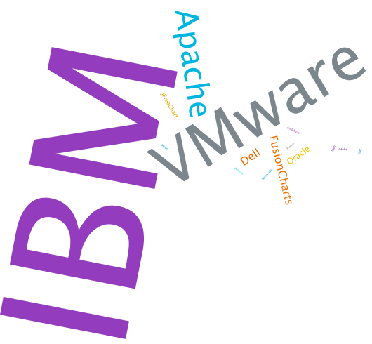


Pierre Ernst
Software development background
Secure Code Review
Found security vulnerabilities in applications made by:
@e_rnst
linkedin.com/in/pernst
Source:
http://www.wordle.net

Slide 4

Salesforce
Trust team
https://research.trust.salesforce.com/
Salesforce is hiring application security engineers for:
Enterprise Security (Vendor applications)
Product Security (Salesforce web applications)
Infrastructure Security (Salesforce network and Linux environment).
Contact:
James Sale, Principal Technical Recruiter
jsale@salesforce.com
415-633-6059
linkedin.com/in/jamesgsale

Slide 5
Java Serialization 101
The Big Picture
serialize
deserialize
00000000 AC ED 00 05 73 72 00 11 62 6F 6E 68 6F 6D 6D 65 ....sr..bonhomme
00000010 2E 43 61 72 6E 61 76 61 6C 20 51 75 65 62 65 63 .Carnaval Quebec
00000020 20 02 00 00 78 70 ...xp
Notes:
AC ED 00 05: Remember this

Slide 6
Java Serialization 101
Convert Java instance to/from a binary stream
Used for persistence (file, database blob)
Used for transmission (RMI: Remote Method Invocation)
Java API:
ObjectOutputStream: to serialize (write)
ObjectInputStream: to deserialize (read)
JVM knows how to (de)serialize primitive types
JVM uses reflection and Unsafe to (de)serialize members of any given class.
Must implements interface java.io.Serializable

Slide 7
Fixing the Java Serialization mess
Introduction to Java serialization
Attack vectors
Serialization Gadgets
Demo: Denial of Service
Deserialization endpoints
Demo: JMX (CVE-2016-3427)
Mitigation
Against Serialization Gadgets
Against Deserialization endpoints
Demo: Bypassing Apache TomEE look-ahead class name blacklist
New concept: Look-ahead method blacklist

Slide 8
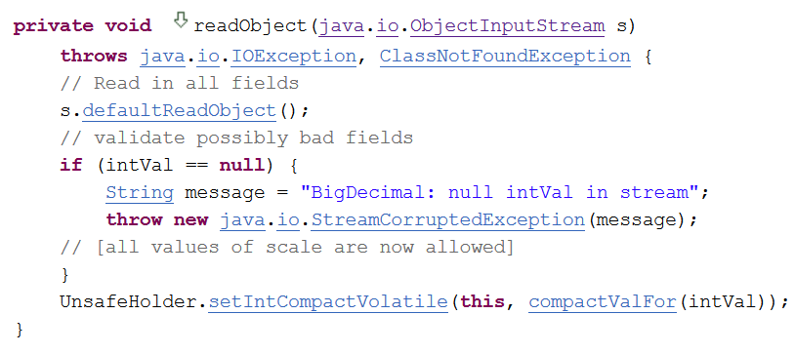
What could possibly go wrong?
Some classes require special handling
writeObject() and readObject() methods
e.g.: java.math.BigDecimal
An application is vulnerable if:
deserializing untrusted input,
and existing classes on the classpath have “unsecure” readObject() method
The readObject() methods can be chained, abused
“gadget” in reference to ROP gadgets
Similarly, some other methods can also be abused (TBD later):
“Magic Methods”
Notes:
Root cause is *NOT* weak boundary between data & code
Magic methods not always present
But if present -> always called during deserialization

Slide 9
Prior Art (pre-2016)
Date | Type | Product | Researcher(s) | Reference
Apr 2005 | DOS | JRE | Marc Schönefeld | CVE-2004-2540
Aug 2008 | Applet->RCE | JRE | Sami Koivu | CVE-2008-5353
Apr 2010 | Applet->RCE | JRE | Sami Koivu | CVE-2010-0094
Mar 2010 | DOS | Sun Java Web Console | Luca Carettoni | Source Code
Sept 2011 | RCE | Spring Framework | Wouter Coekaerts | CVE-2011-2894
Oct 2012 | RCE | IBM Cognos BI | Pierre Ernst | CVE-2012-4858
Feb 2013 | File Write->RCE | Apache OpenJPA | Pierre Ernst | CVE-2013-1768
Mar 2013 | File Write->RCE | Apache Tomcat | Pierre Ernst | CVE-2013-2185
July 2015 | RCE | Apache Groovy | "cpnrodzc7" | CVE-2015-3253
Aug 2015 | Buffer Overflow->RCE | Android | Or Peles & Roee Hay | CVE-2015-3837
Nov 2015 | RCE | Apache Commons Collections | Chris Frohoff & Gabriel Lawrence | CVE-2015-7450
Nov 2015 | DOS | JRE | Wouter Coekaerts | Source Code

Slide 10
Attack Surfaces: Endpoints Vs. Gadgets
Attacker
Vulnerable Service
JVM
Deserialization (bonhomme.Carnaval.class)
Malicious serialized input (Vulnerable.class)
1
bonhomme.Carnaval instance = (bonhomme.Carnaval)in.readObject();
Vulnerable
classpath
Calls “magic” method
private void readObject
(ObjectInputStream in) {
}
2
Notes:
Successful exploitation requires both attack surfaces

Slide 11
Fixing the Java Serialization mess
Introduction to Java serialization
Attack vectors
Serialization Gadgets
Demo: Denial of Service
Deserialization endpoints
Demo: JMX (CVE-2016-3427)
Mitigation
Against Serialization Gadgets
Against Deserialization endpoints
Demo: Bypassing Apache TomEE look-ahead class name blacklist
New concept: Look-ahead method blacklist

Slide 12
Class is vulnerable if:
It has a “magic” method that can be abused
What are the “Magic” methods?
readObject()
readResolve()
validateObject()
readObjectNoData()
readExternal()
finalize()
<init>()

Slide 13
How can magic methods be abused?
Any side effect with security impact
File I/O
Network I/O
Code injection
Denial of service
…

Slide 14
Fixing the Java Serialization mess
Introduction to Java serialization
Attack vectors
Serialization Gadgets
Demo: Denial of Service
Deserialization endpoints
Demo: JMX (CVE-2016-3427)
Mitigation
Against Serialization Gadgets
Against Deserialization endpoints
Demo: Bypassing Apache TomEE look-ahead class name blacklist
New concept: Look-ahead method blacklist

Slide 15
Java Memory Exhaustion
private void readObject(ObjectInputStream in)
throws IOException, ClassNotFoundException {
int len = in.readInt();
this.parameters = new Object[len];
// ...
}
Controlled by attacker
Memory exhaustion
Pervasive problem
com.sun.xml.internal.ws.protocol.xml.XMLMessageException
java.util.concurrent.CopyOnWriteArrayList
java.util.logging.LogRecord
java.util.PriorityQueue
org.apache.catalina.tribes.membership.MemberImpl
Notes:
The attacker can control anything that has been read from the stream, or any member that has been deserialized with the default behavior

Slide 16
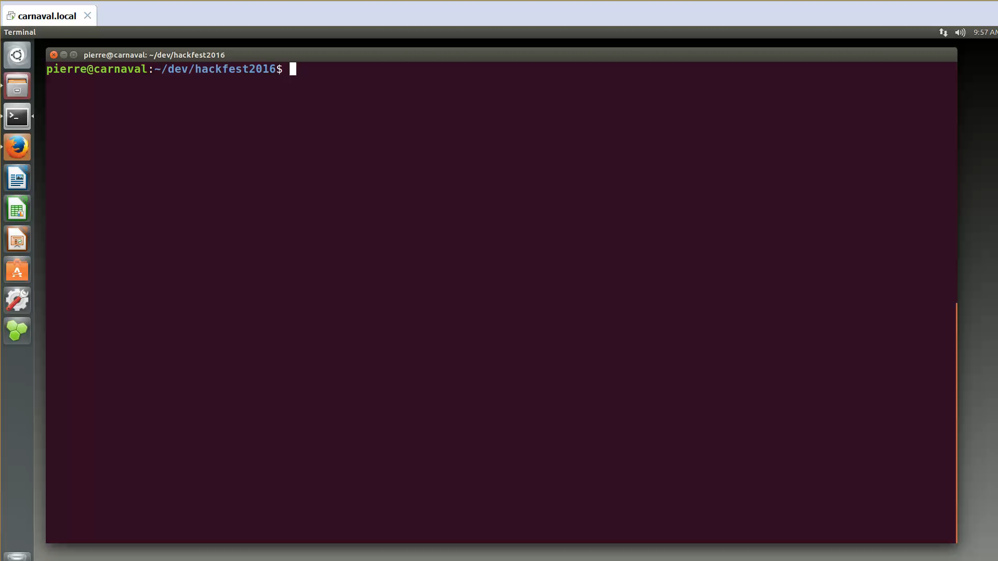

Slide 17
Fixing the Java Serialization mess
Introduction to Java serialization
Attack vectors
Serialization Gadgets
Demo: Denial of Service
Deserialization endpoints
Demo: JMX (CVE-2016-3427)
Mitigation
Against Serialization Gadgets
Against Deserialization endpoints
Demo: Bypassing Apache TomEE look-ahead class name blacklist
New concept: Look-ahead method blacklist

Slide 18
Endpoint is vulnerable if:
It deserializes user’s input
java.io.ObjectInputStream ois =
new java.io.ObjectInputStream(/* contains user’s input */)
ois.readObject();
/* OR */
ois.readUnshared();

Slide 19
Fixing the Java Serialization mess
Introduction to Java serialization
Attack vectors
Serialization Gadgets
Demo: Denial of Service
Deserialization endpoints
Demo: JMX (CVE-2016-3427)
Mitigation
Against Serialization Gadgets
Against Deserialization endpoints
Demo: Bypassing Apache TomEE look-ahead class name blacklist
New concept: Look-ahead method blacklist

Slide 20
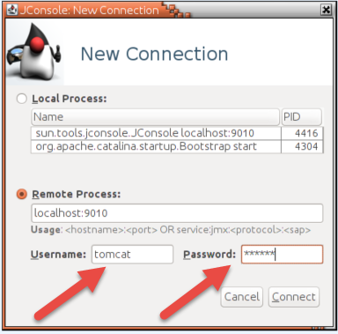
CVE-2016-3427
JMX untrusted deserialization
Fixed in Java 8 Update 91 (April 2016)
JMX = Java Management eXtensions
API for managing/monitoring resources
Client-Server on TCP/IP
Optional features:
TLS socket
Authentication
!

Slide 21
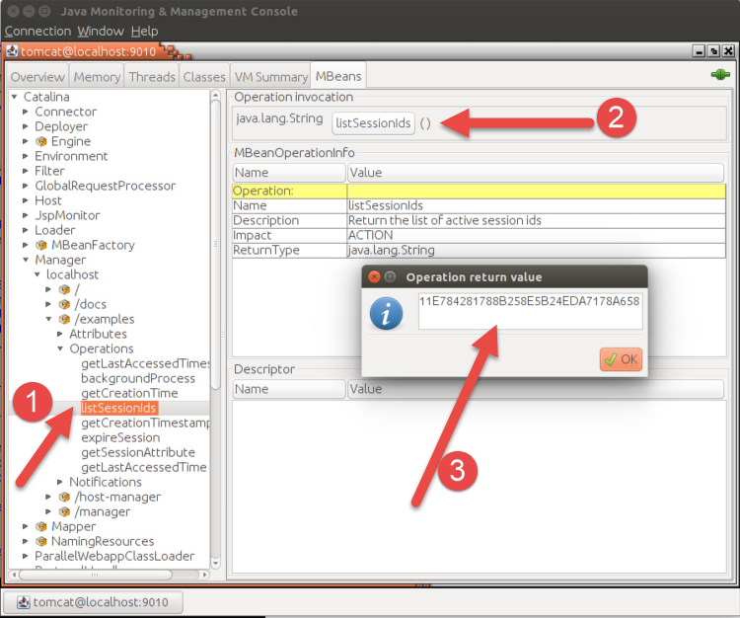
Prior JMX vulnerabilities
Abusing Existing Features
Tomcat JMX
Retrieving all the session ids

Slide 22
Prior JMX vulnerabilities
RCE with MLet
Only vulnerable when authentication is not enabled
Source:
Exploiting JMX RMI
Class MLet
evil.org
victim.com
JMX connect
createMBean
javax.management.loading.MLet
load
evil bean
invoke

Slide 23
JMX Connection Strings
a.k.a JMX “URLs”
service:jmx:rmi://bonhomme.local:10002/jndi/rmi://bonhomme.local:10001/jmxrmi
JMX endpoint
rmi://bonhomme.local:10002
rmi://bonhomme.local:10001/jmxrmi
Naming Registry
How many times did you read “RMI” ?
JMX connection strings is future-proof
Might use some other transport technologies in the future
But it relies on RMI for now.
We can use RMI directly to connect to a JMX server

Slide 24
Connecting to JMX with RMI
(directly)
service:jmx:rmi://bonhomme.local:10002/jndi/rmi://bonhomme.local:10001/jmxrmi
Registry registry = LocateRegistry.getRegistry("bonhomme.local", 10001);
RMIServer rmiServer = (RMIServer) registry.lookup("jmxrmi");
RMIConnection rmiConnection = rmiServer.newClient(new String[]{
"tomcat", "secret"});

Slide 25
What is RMI again?
RMI:
Client-Server network protocol
RPC-style
Uses serialization
RMI Call
00000000 50 AC ED 00 05 77 22 A1 F2 A2 CB 82 19 D4 02 D0 P....w".........
00000010 70 E5 1A 00 00 01 57 52 A7 43 A2 80 01 FF FF FF p.....WR.C......
00000020 FF F0 E0 74 EA AD 0C AE A8 75 72 00 13 5B 4C 6A ...t.....ur..[Lj
00000030 61 76 61 2E 6C 61 6E 67 2E 53 74 72 69 6E 67 3B ava.lang.String;
00000040 AD D2 56 E7 E9 1D 7B 47 02 00 00 70 78 70 00 00 ..V...{G...pxp..
00000050 00 02 74 00 06 74 6F 6D 63 61 74 74 00 06 73 65 ..t..tomcatt..se
00000060 63 72 65 74 cret
Notes:
It would be nice if we could send something else than String[]…

Slide 26
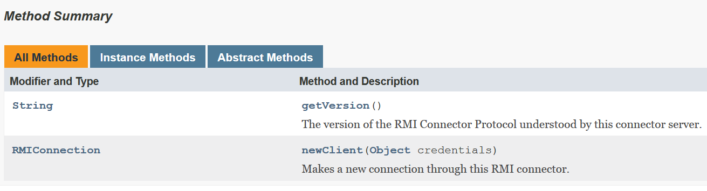
RMIServer API
https://docs.oracle.com/javase/8/docs/api/javax/management/remote/rmi/RMIServer.html
Deserialization happens before authentication can even take place

Slide 27
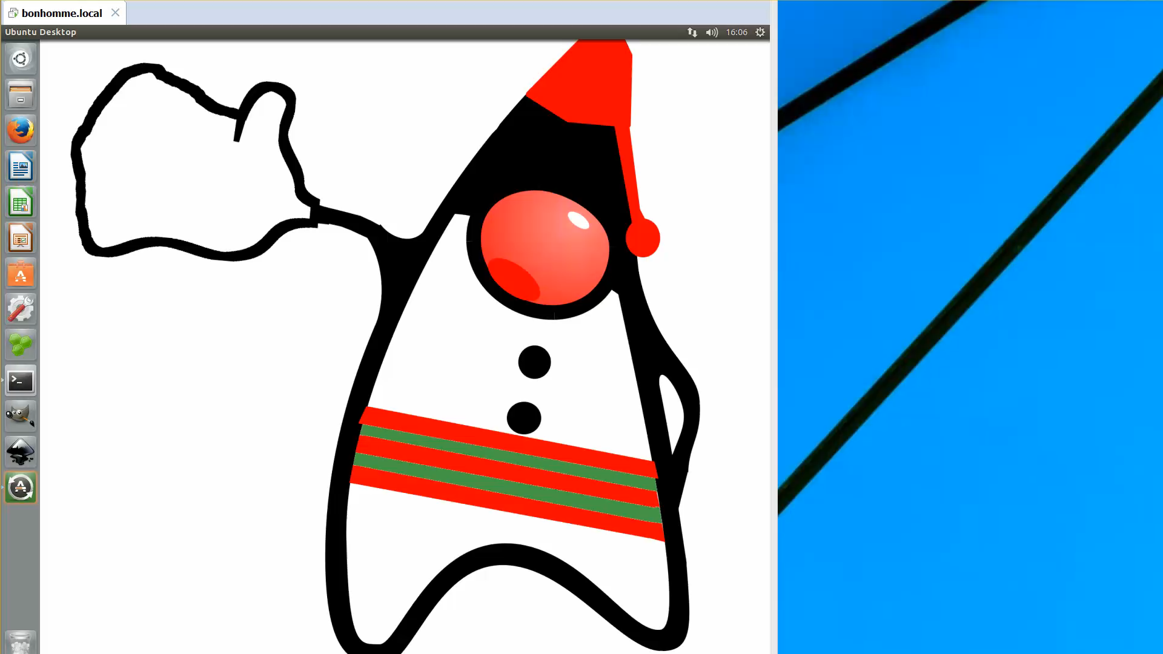
Notes:
Vulnerable even if authentication is enabled (happens before)
Tomcat used as an example

Slide 28
Fixing the Java Serialization mess
Introduction to Java serialization
Attack vectors
Serialization Gadgets
Demo: Denial of Service
Deserialization endpoints
Demo: JMX (CVE-2016-3427)
Mitigation
Against Serialization Gadgets
Against Deserialization endpoints
Demo: Bypassing Apache TomEE look-ahead class name blacklist
New concept: Look-ahead method blacklist

Slide 29
Where do we fix it?
The Blame Game
“Applications should never deserialize untrusted input”
1
vs.
“3rd party libraries should only have secure magic methods”
2

Slide 30
In both places!
Defense in Depth

Slide 31
Fixing the Java Serialization mess
Introduction to Java serialization
Attack vectors
Serialization Gadgets
Demo: Denial of Service
Deserialization endpoints
Demo: JMX (CVE-2016-3427)
Mitigation
Against Serialization Gadgets
Against Deserialization endpoints
Demo: Bypassing Apache TomEE look-ahead class name blacklist
New concept: Look-ahead method blacklist

Slide 32
Making “magic” methods more secure
Does the class really need to be serializable?
Can we add input validation?
Prevent path traversal
Prevent resource exhaustion
…

Slide 33
Fixing the Java Serialization mess
Introduction to Java serialization
Attack vectors
Serialization Gadgets
Demo: Denial of Service
Deserialization endpoints
Demo: JMX (CVE-2016-3427)
Mitigation
Against Serialization Gadgets
Against Deserialization endpoints
Demo: Bypassing Apache TomEE look-ahead class name blacklist
New concept: Look-ahead method blacklist

Slide 34
Fix: Java API change
today
bonhomme.Carnaval obj = (bonhomme.Carnaval)ois.readObject();
tomorrow?
bonhomme.Carnaval obj =
ois.readObject(bonhomme.Carnaval.class);
Notes:
New Argument: Class or Class[]

Slide 35
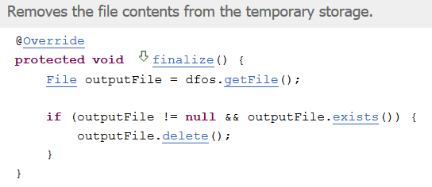
Mitigation: Sandboxing
Deserialization inside a block protected by a Security Manager
Could prevent “malicious” calls
File R/W access
Process creation
Network access
…
Not recommended:
Hard to fine-tune: what is legitimately required?
Known to be broken
e.g. CVE-2013-4444 code inside finalize() can be abused
Notes:
Strongly encourage to stop using deserialization altogether

Slide 36
Mitigation: Class Name Input Validation
Look-ahead Java deserialization, Jan 2013, Pierre Ernst
Concept used by various validation libraries
SerialKiller, by Luca Carettoni
contrast-rO0 by Contrast Security
JDK enhancement proposal #290 and CERT Secure Coding SER12-J
We want to validate which classes get deserialized
Object Serialization Stream Protocol defines a class description
STREAM_MAGIC
TC_CLASSDESC
TC_OBJECT
className
STREAM_VERSION
className
00000000 AC ED 00 05 73 72 00 11 62 6F 6E 68 6F 6D 6D 65 ....sr..bonhomme
00000010 2E 43 61 72 6E 61 76 61 6C 20 51 75 65 62 65 63 .Carnaval Quebec
00000020 20 02 00 00 78 70 ...xp
serialVersionUID
classDescFlags
fields
TC_NULL
TC_ENDBLOCKDATA
So we could use our own binary parser to decide whether we should stop reading …
… or use existing Java API that allows us to add our own validation hook.

Slide 37
Look-ahead Java deserialization
Adding your own validation hook
Callback provided by Java
Normally used for custom class loading
public class LookAheadObjectInputStream extends ObjectInputStream {
@Override
protected Class<?> resolveClass(ObjectStreamClass desc) {
if ( ! desc.getName().equals("bonhomme.Carnaval") ) {
throw new InvalidClassException(
"Unauthorized deserialization attempt",
desc.getName());
}
return super.resolveClass(desc);
}
}

Slide 38
Look-ahead Java deserialization
Two ways of validating class names
White-listing classes that are OK to deserialize
Tedious, Impossible in real life scenario?
Black-listing classes known to have “bad” “magic” methods
a.k.a. Whack-a-mole
Known to be broken
RSA conference
2016-03-04
Alvaro Muñoz
Christian Schneider
public class NestedProblems implements Serializable{
private void readObject(ObjectInputStream in) {
ObjectInputStream ois = new ObjectInputStream(
/* attacker controlled input */);
ois.readObject();
}
}

Slide 39
Fixing the Java Serialization mess
Introduction to Java serialization
Attack vectors
Serialization Gadgets
Demo: Denial of Service
Deserialization endpoints
Demo: JMX (CVE-2016-3427)
Mitigation
Against Serialization Gadgets
Against Deserialization endpoints
Demo: Bypassing Apache TomEE look-ahead class name blacklist
New concept: Look-ahead method blacklist

Slide 40
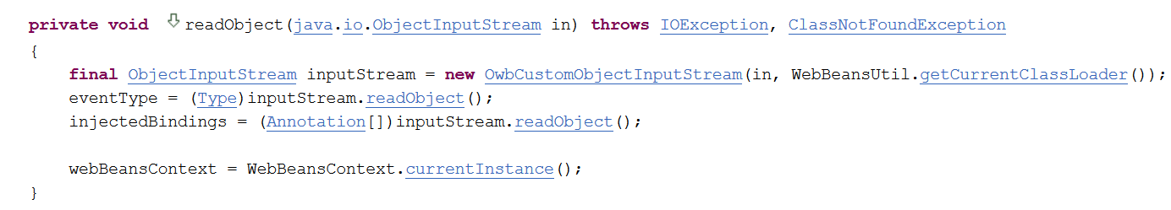
Class Name Input Validation Bypass
Black List mode
Springboard classes:
org.apache.webbeans.inject.impl.InjectionPointImpl
org.apache.webbeans.inject.instance.InstanceImpl
org.apache.webbeans.event.EventImpl
Fixed in Apache TomEE 7.0.1 (June 2016)
Fixed in Apache OpenWebBeans 1.5.0 (October 2015)
new
Notes:
Only an issue when using blacklist mode

Slide 41
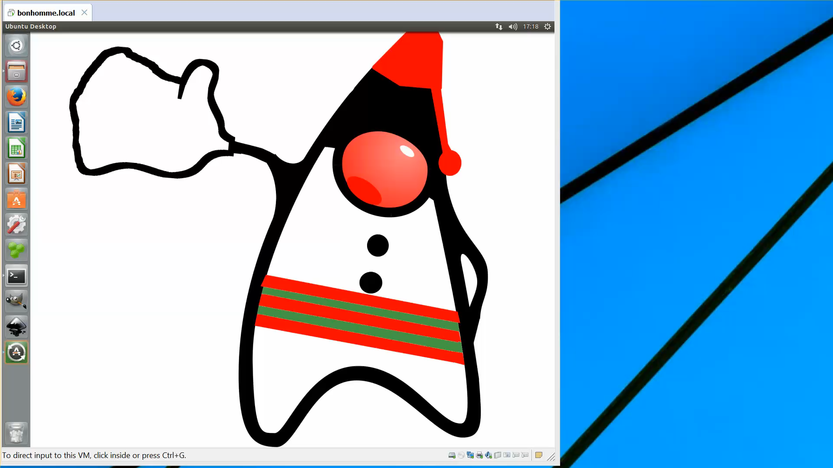

Slide 42
Fixing the Java Serialization mess
Introduction to Java serialization
Attack vectors
Serialization Gadgets
Demo: Denial of Service
Deserialization endpoints
Demo: JMX (CVE-2016-3427)
Mitigation
Against Serialization Gadgets
Against Deserialization endpoints
Demo: Bypassing Apache TomEE look-ahead class name blacklist
New concept: Look-ahead method blacklist

Slide 43
Mitigation: Look-ahead Method Blacklist Input Validation
Called methods
methodA
methodB
Black List
method1
method2
Class x.y.z
yes
Analyze
Magic method
yes
Magic methods?
blacklisted methods?
reject
no
no
accept
Notes:
Springboard classes rejected by default

Slide 44
Check it out
Source code with POC implementation published

Slide 45
Putting everything together
Mitigation
Security Manager
Look-ahead Class name validation
Whitelisting
Blacklisting
Look-ahead Method blacklisting
P
!
Notes:
Security Manager is not enough, but it still adds value

Slide 46
Serialization:
Don’t use it
Class name whitelisting
Method blacklisting

